Slide 1



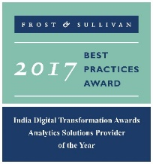


LatentView Capabilities – Overview
December 2017
An Introduction
Actionable Insights. Accurate Decisions
2009-2016

Slide 2
Agenda
1
About LatentView
2
Data Engineering to Accelerate Analytics
3
Connecting Analytics Initiatives to Business Goals By Optimization
4
Advanced Analytics for Real Time Decision Making
5
Leveraging Unconventional Data for Business Insights

Slide 3

About LatentView

Slide 4




LatentView at a glance
Awards & Recognition
Founded in
Over
Grown
Work with
Strong Performer - Customer Analytics Services, 2017
530
11
25+
2006
People strong
times in last
six years
Fortune 500
firms
Member of
2009-2016
Technology council
Frost & Sullivan
Analytics Solutions Provider 2017
Only company recognized
Repeat
Business at
4/5
9
top technology companies work with us
>85%
#1
consecutive times in Deloitte Technology Fast50
Analytics Company of the Year 2015

Slide 5




















Who we work with

Slide 6




Key customer highlights
Profile Driver behavior to predict vehicle risks
A real-time platform designed to increase transactions
Leverage analytics for personalization at scale
Mining unconventional data sources for smarter insights

Slide 7
Data Engineering to Accelerate Analytics

Slide 8
Current State of Data Platforms
How is data acquired?
How is data staged for analytics?
How is consumption enabled?
Ingestion & Storage
Data Variety
Mostly Structured
Disparate systems for Unstructured
Traditional ETL
Data Volume
Limited Capacity
On Premise Considerations
Scheduled Archival & Restoration
Transformation
Data Veracity
Data Silos
No central view of metrics
Lack of metadata and lineage
Data Velocity
Tightly coupled dependencies
Cascading failures
Information Delivery
Analytics Workloads
Data Warehouse for all use cases
Reporting
Advanced Analytics by Business
Throttling usage
Access restrictions impacts lead time

Slide 9
Ideal Data Platform – Design Considerations
How is data acquired?
How is data staged for analytics?
How is consumption enabled?
Ingestion & Storage
Data Variety
Mostly Structured
Disparate systems for Unstructured
Traditional ETL
Data Volume
Limited Capacity
On Premise Considerations
Scheduled Archival & Restoration
Transformation
Data Veracity
Data Silos
No central view of metrics
Lack of metadata and lineage
Data Velocity
Tightly coupled dependencies
Cascading failures
Information Delivery
Analytics Workloads
Data Warehouse for all use cases
Reporting
Advanced Analytics by Business
Throttling usage
Access restrictions impacts lead time
Enablers
Process – SLAs
Technology – On-premise, Cloud, Hybrid
Cost – Accountability & Process Transparency
Deployment – Prototype to Production
Data Governance & Security
ACLs

Slide 10
Technology Architecture to Accelerate Analytics
How to acquire data?
How to create a unified data view?
How to enable consumption?
CANNED REPORTS
Data Integration
Relational Data Store
(Ex: AWS Redshift)
Enterprise Reporting Platform
Conventional Data Sources
Structured
Data Lake
(Example: S3)
SELF SERVICE BI
Unconventional Data Sources
Indexing and Querying
(Ex: Elastic Search)
API endpoints
OPERATIONAL
External Data Sources
Unstructured
Machine Learning Workbench
ADVANCED ANALYTICS
Distributed Processing
Feature Engineering
Data Sampling
(Ex: Spark)
Internal Data Sources
Real time Indexing
(Ex: Elastic Cache)
REAL TIME REPORTING
Data Type specific ETL toolset
Isolating Compute from Storage
Workload Aware Compute

Slide 11
Case Study in Detail: Sysco Gravity

Slide 12







Customer Demands
Prototype & Productionize Product Recommendation Engine At Scale
Enable new metrics development – Order line level logistics attribution
API for Data Products – Deal Broker Application, Recommendation Results
Operational Reporting by field sales managers (Highly concurrent request pattern)

Slide 13




















Centralized Data Repository – Engineering Components
Catalog & Search
Access & Search metadata
Access & User Interface
Provide easy & secure access
Glue Catalog
Dynamo DB
Elastic Search
API Gateway
Lambda
IAM
Cognito
Processing & Analytics
Enable predictive analytics
Gravity : Repository Backend Code
Pull data from different sources into centralized repository in a optimized way
Central Storage
Secure, cost-effective
storage in Amazon S3
S3
Athena
EMR
Redshift
Machine
Learning
RedShift
Input Data Sources
S3
Protect and Secure
Use entitlements to ensure data is secure and users’ identities are verified
Identity & Access
Management
Security Token
Service
CloudWatch
CloudTrail
Key Management
Service
User Interface

Slide 14
Snapshot of Select Projects Data Engineering

Slide 15




Snapshot of Select Projects : Data Engineering
Other examples of LatentView’s Data Engineering Expertise
Warner Bros
Hitachi Vantara
Built a high throughput, high volume clickstream data pipeline that enables a 360 degree view of the customer and helps product teams to see deep in to what drives user behaviour and how they can impact it.
Drives 1/3 of all business insights
Complex queries with sub minute response on TBs of data
10x faster than conventional setup
Provisioned cloud based scalable infrastructure and seamlessly migrated and enabled access of existing VPC’s, Subnets, IAM Users & Roles, Environments, Dashboards etc. supporting the digital supply chain processes for Home Entertainment
Enabled fast analytical querying, particularly on large datasets
Ensured on-time delivery of the digital contents resulting in $500K annual savings
Assessed existing data & reporting architecture of organization and redesigned the architecture and KPI framework inline with business objectives along with a detailed analytics roadmap for the organization.
Analytics Roadmap
Business & Analytics aligned architecture
Consulting on the ongoing implementation

Slide 16
Connecting Analytics Initiatives to Business Goals By Optimization

Slide 17








Connecting Analytics Initiatives to Business Goals by Optimization
What is JARVIS ?
Business Decision Making Pipeline
Identify and Quantify Key Drivers
(Ex: Acquisition Rate, Monthly Balance)
Build Models to map drivers to actionable metrics / KPIs
(Ex: Financial Model)
Compute & Visualize KPIs
(Ex: Cash Flows, Net Present Value)
Take a Business Decision
(Ex: Change Price, Run Campaigns)
Optimization – Bridges the gap between business and analytics to deliver maximum business value
Collect Data
(Transactions, Observations and Interactions)
Manage Data
(Data engineering to store and ensure quality of data)
Analyze Data
(Apply Math to Data)
Derive Insights
(Decipher patterns and get predictions)
Data Science Pipeline
Notes:
Demo Link & Credentials
URL: https://52.44.241.227/index.html#portfolios
Username: superuser
Password: solveit@123

Slide 18
Case Study in Detail: Sears 95/5

Slide 19








Supply Chain : Business Context
Objective :
To enhance the business performance from existing 45% to 95% service levels that impacts 13 Million Customer Service requests annually
13 Million Customer Requests
Capacity Planning & Managing response time
Increase in Service Levels from 45% to 95%
Predictive Modelling & Advanced diagnostic
Methodology
Preliminary analysis
Identified 4 nodes/opportunity in value chain for improvement
Advanced Diagnostics
Response Time
First Time Completes
Parts & Delivery
Improving business Performance
Advanced Diagnostics
Response Time (RT)
First Time Complete (FTC)
Parts & Delivery
Solution
Analytics solutions varying from dashboarding, text mining to predictive modelling and stochastic optimization were implemented for the 4 nodes.
Visualization
Diagnostic analysis
Predictive Modelling
Simulation & Optimization

Slide 20
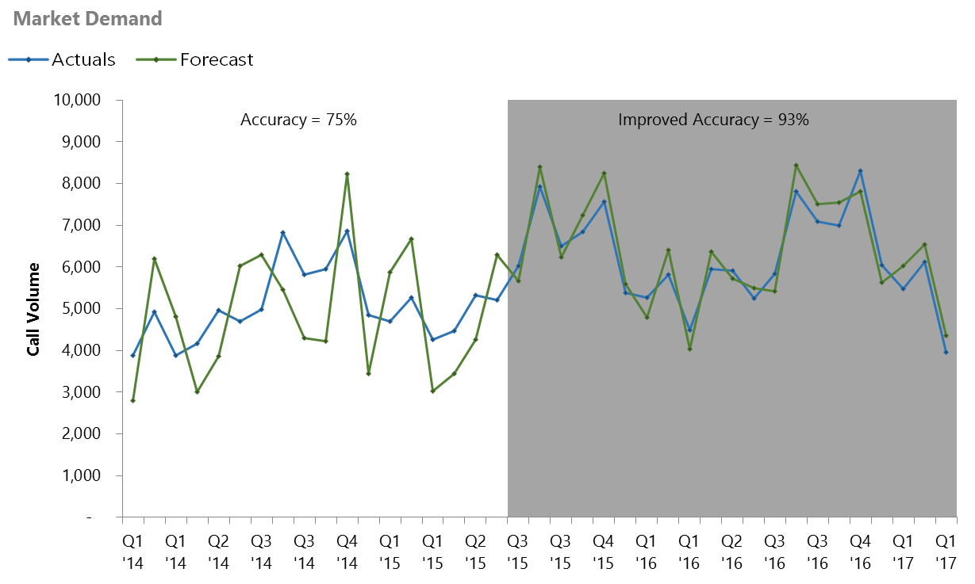



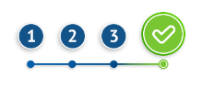

Supply Chain : Sales & Operations Planning Framework
BOTTLENECKS
SOLUTION
IMPACT
Bottlenecks in previous state
We identified a lack of maturity in the S&OP process in terms of processes, data, and tools to more effectively plan demand.
Low segment accuracy: Lack of visibility into downstream usage of data, cannot capture change in demand across markets
Incompatible demand planning and forecast process: Forecast generated cannot be directly compared with the planned demand
Rudimentary planning process: No periodic updates to the process or exception alerts to mitigate outliers
No Single plan number: Each function operates with a different view of demand plan

Slide 21



Supply Chain : Sales & Operations Planning Framework
Supply Chain : Sales & Operations Planning Framework
BOTTLENECKS
SOLUTION
IMPACT
Solution Framework
Use External data such as holidays and weather forecast to more accurately capture variations in demand and deliver for 40K+ segments
1
2
Data gathering & business inputs
Baseline forecast
generation
Measure accuracy, Improve Model
4
Finalize forecast and Demand plan
3
Executive review and Consensus demand
Methodology
Combine forecasts from different algorithms to boost the accuracy ARIMA, ETS, TBATS or Holt-Winters
Determine if the time series requires any additional transformations
Treatment of missing Values
Outlier Treatment
Feature Engineering
Data Transformation
Choose the model with best accuracy fit
Accuracy (WAPE) calculated at the end of each monthly cadence ; flag poorly performing segments for improvement

Slide 22


Supply Chain : Sales & Operations Planning Framework
BOTTLENECKS
SOLUTION
IMPACT
Impact
Accurate forecasts
Improved overall Demand Forecast Accuracy from 65% to 92%; Most granular levels accuracy at 84%
Lead time to customer
Reduced lead times by 20% to the consumer, improving overall service levels

Slide 23



Supply Chain : Supply Planning & Optimization
Supply Chain : Supply Planning & Optimization
Workforce Optimization
Business Impact
Project supply based on Efficiency factors of techs, expected demand and availability of service technicians
Capacity Metrics
Identify Gap/Surplus between demand and optimized capacity at each market segment level
Reduce Idle Capacity and Ensuring minimal gaps in high Demand geographies
Insights & Reporting through web tool and enable Analysts to provide commitments to meet Weekly Demand
US $5 million per annum in incremental revenue as a result of reduced cancellations
Full Time Equivalents
Model Inputs to Optimizer
Availability of Technician
Time taken to complete
Case load
Overall Capacity
Tech Efficiency
Tech Avaliablity Period
Optimize Supply
Analyze technician availability and historical cycle times to build the overall Capacity
Tech Skills
Run a Quadratic optimization model using Solver in Python to minimize Gap/Surplus and Optimize workforce supply
Notes:
Objective:
The objective was to Optimize resource allocation within district while minimizing gap between demand and supply of techs
LatentView Solution
Latentview developed and optimization solution through PULP, python based optimization frame work
The Solution included finding optimized allocation across all 40 districts – Total number of segments - ~6500
Optmization is run every week, to take into account real time events
Supply is optimized for 12 Week period
Business Benefits
The operations team uses the optimized supply to allocate resources within districts and product categories
Cost savings through reallocation of surpluses to other market segments
Long term cost savings through efficient management and allocation of resources
Inputs
Capacity for a Year - Week
Completes
Technician
Product Category
IRU (Individual Revenue Unit)
DRU (District Revenue Unit)
Demand for a Year – Week
Technician
Product Category
IRU
DRU
Availability / Capability
Technician
Product Category
IRU
The Capacity at a technician level, which is the input for model is calculated as
C=A × CPH
Where:
A -> Availability, which is scheduled hours of a Full-time technician in a given week. 8 hours is considered to comprise a day’s work with a max. of 5 working days in a week. 0.000 ≤A ≤40.000
CPH -> Calls per hour of a technician, calculated as:
Obtain no. of services completed & days worked. Four weeks considered are (current week – 5) to (current week -2)
Prepare table to forecast for future supply for 13 weeks from current week
Obtain no. of hours worked or plan to work (true bookable hours)
Completes per hour, CPH is calculated as : (Completes/Bookable hours)
The bookable hours comes from the table, HS_HR_VIEWS.ih_ScheduledHoursTechnician
Average CPH is calculated as:
Avg. CPH = sum (CPH) / No. of weeks worked
For the period : (current week - 5 to current week - 2). Limit maximum CPH to 2 to account to keep values closer to reality.
Get forecasted completed services as: Avg. CPH X Bookable hours
Bookable hours is the scheduled work hours of the technician for the upcoming week.
Note: Unless specified otherwise each row is aggregated for a technician in a week at prodcat X iru level
Objective Function:
For Each given DRU in a given week,
min. $f=\sum_{i=A}^{n}{\left(D_{ij}−\sum_{k}{\left(α_{ijk} ×C_{ijk}\right)}\right)}$
SUBJECT TO CONSTRAINTS:
D-C ≥0
0 ≤ α ≤1
∀ i^th IRU & Product Category
j^th Week
k^th Technician
d^th DRU
α Allocation (0,1)
Where
D is the Demand at DRU X IRU X Product Category level
C is the Capacity at a Technician Level for a given IRU X Product Category combination

Slide 24

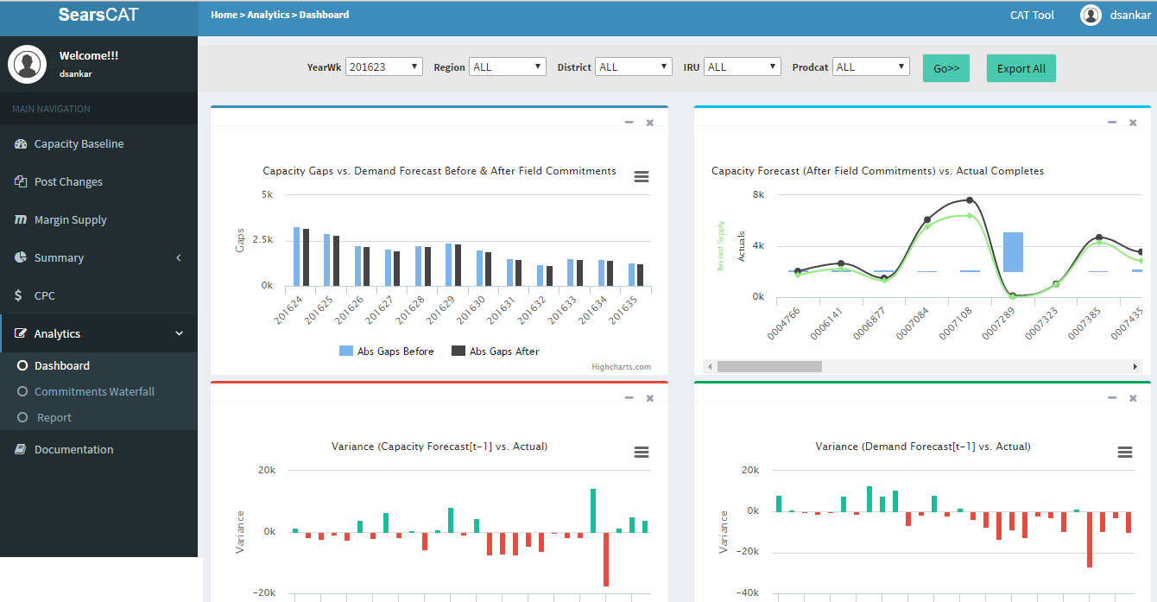
Supply Chain : Dynamic Capacity Reallocation
Enable Reallocation of Capacity on changing Demand
Business Impact
Identify Gap/Surplus between demand and optimized capacity at each market segment level and help plan by Reducing Idle Capacity and Ensuring minimal gaps in high Demand geographies
Internal Data
Enabled identification of opportunities worth an additional US$300,000 every year
The annual savings in capacity management were increased by US $ 25,000 every year.
Provide insights on metrics like Response Time, Trips per Repair, Gap/Surplus at each market segment
Demand Forecast
Data warehousing
ETL process setup to
synchronize
Response Time
Develop & Maintain the analytics interface
Overall Capacity
Gaps/Surplus
Operational LP analytics and Validation
Setup & maintain a data mart in SQL server
Recommended Actions
Identify Gap/Surplus between demand and optimized capacity at each market segment level
Notes:
Objective:
Enable operations team to plan allocation of technicians and distribute workforce optimally
Problem: Minimize the Gap/Surplus between Demand and Capacity at each Market Segment across the country
Develop a web application enabling a centralized workforce planning mechanism
Solution:
Analyze technician availability and historical cycle times to build the overall Capacity
Linear Optimization in Python to minimize Gap/Surplus and Optimize workforce supply
Setup & maintain a data mart in SQL server
Developed a web application in ASP.NET MVC to facilitate capacity analysis
Business Benefits:
Identify Gap/Surplus between demand and optimized capacity at each market segment level
Reduce Idle Capacity and Ensuring minimal gaps in high Demand geographies
Insights & Reporting through CAT tool and enable Analysts to provide commitments to meet Weekly Demand

Slide 25
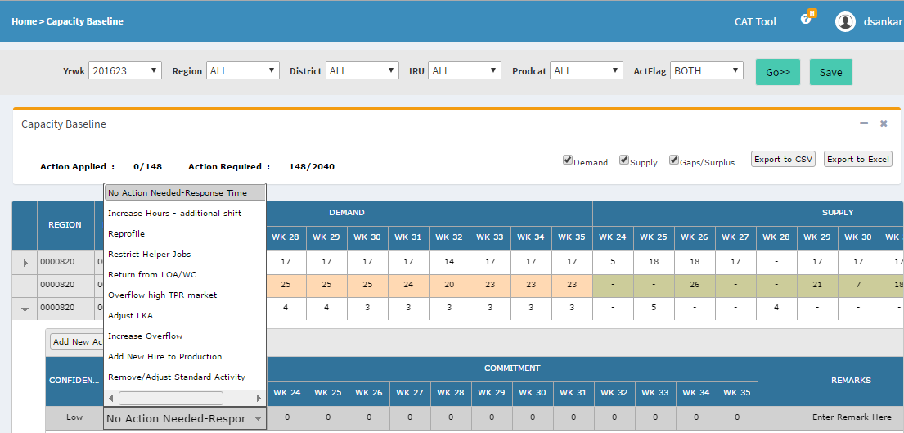
Supply Chain : Supply Planning & Optimization
Enabling Capacity Analysts at Client to distribute workforce optimally
Provide insights on metrics like Response Time, Trips per Repair, Gap/Surplus at each market segment
Enable Analysts to provide commitments for their territory in the next 3 months to meet Weekly Demand
Also tracks accuracy and fulfilment of commitments provided in previous weeks.
Reporting on Call Margins, Weekly summary of Demand Met and Interactive Dashboard to analyze Accuracy
Benefits:
Provide a Quarterly overview of Gaps/Surplus between Demand & Supply to plan for Capacity augmentation, if needed
Identify markets segments with surplus & high margins post optimization to tap growth opportunities
Notes:
Objective:
The objective was to Optimize resource allocation within district while minimizing gap between demand and supply of techs
LatentView Solution
Latentview developed and optimization solution through PULP, python based optimization frame work
The Solution included finding optimized allocation across all 40 districts – Total number of segments - ~6500
Optmization is run every week, to take into account real time events
Supply is optimized for 12 Week period
Business Benefits
The operations team uses the optimized supply to allocate resources within districts and product categories
Cost savings through reallocation of surpluses to other market segments
Long term cost savings through efficient management and allocation of resources
Inputs
Capacity for a Year - Week
Completes
Technician
Product Category
IRU (Individual Revenue Unit)
DRU (District Revenue Unit)
Demand for a Year – Week
Technician
Product Category
IRU
DRU
Availability / Capability
Technician
Product Category
IRU
The Capacity at a technician level, which is the input for model is calculated as
C=A × CPH
Where:
A -> Availability, which is scheduled hours of a Full-time technician in a given week. 8 hours is considered to comprise a day’s work with a max. of 5 working days in a week. 0.000 ≤A ≤40.000
CPH -> Calls per hour of a technician, calculated as:
Obtain no. of services completed & days worked. Four weeks considered are (current week – 5) to (current week -2)
Prepare table to forecast for future supply for 13 weeks from current week
Obtain no. of hours worked or plan to work (true bookable hours)
Completes per hour, CPH is calculated as : (Completes/Bookable hours)
The bookable hours comes from the table, HS_HR_VIEWS.ih_ScheduledHoursTechnician
Average CPH is calculated as:
Avg. CPH = sum (CPH) / No. of weeks worked
For the period : (current week - 5 to current week - 2). Limit maximum CPH to 2 to account to keep values closer to reality.
Get forecasted completed services as: Avg. CPH X Bookable hours
Bookable hours is the scheduled work hours of the technician for the upcoming week.
Note: Unless specified otherwise each row is aggregated for a technician in a week at prodcat X iru level
Objective Function:
For Each given DRU in a given week,
min. $f=\sum_{i=A}^{n}{\left(D_{ij}−\sum_{k}{\left(α_{ijk} ×C_{ijk}\right)}\right)}$
SUBJECT TO CONSTRAINTS:
D-C ≥0
0 ≤ α ≤1
∀ i^th IRU & Product Category
j^th Week
k^th Technician
d^th DRU
α Allocation (0,1)
Where
D is the Demand at DRU X IRU X Product Category level
C is the Capacity at a Technician Level for a given IRU X Product Category combination

Slide 26


Supply Chain : Inventory Planning
Truck Stock Optimization
Business Impact
Ensure that the right technician with the right parts in service van is dispatched in the first attempt to service a request
Develop an integrated service technician profile and parts planning process based on analysis
Establish planning geographies as foundation for profile and parts planning methodology
Optimize truck stock assortment process
Reduce cost involving multiple attempts on a service request
4% Increase in First Time Completes
Servicing Profitablity Metrics
Identify Key variables for model
Margin
Expected number of first time fixes
No. of requests assigned
Recalls and Reschedules Rate
Expected Profit Generation
Data Mining & Model Building
First Time Completes Rate
Model Validation & Refresh
Output
Assortment of Part level information to be carried in each truck for achieving first time fixes subject to maximized profit
Notes:
SIPOC
Inputs: data modeling requirements, sources, gaps, SMEs, etc.
W2 parametrics
Trucks changeover costs
FTC %
FTC $
Process
NonLinearity contributors
NonSmoothness contributors
ObjFunc maximization
Outputs
Optimal Profiles (and TruckClass)

Slide 27
Snapshot of Select Projects Optimization

Slide 28


Snapshot of Select Projects : Optimization
Other client projects involving optimization
Large US Retailer
Developed a robust risk management strategy to account for the high levels of volatility in the crude oil market using price forecasting models on both the portfolio bunker indices and hedge instruments followed by Non-linear optimization framework to arrive at an optimal hedging strategy
Robust hedging strategy that maximizes returns while minimizing portfolio risks
Enabled the client answer quantitatively:
What is the amount of risk carried in the portfolio?
What instruments should be used for the hedge and in which direction?
How much of the portfolio should be hedged for maximum returns?
Developed a tool which analysed the number of quoters, transactions and purchase rates at days to arrival level for each city to forecast the most optimized bids for ‘first spots’ on travel aggregator websites
Net annual financial impact of $532k
Cost reduction (optimized bids) of $204k
Increase in transactions (higher first spot ad placements) of $328k
Developed a dynamic offer personalization and evaluation mechanism which helps in estimating conversion probability and value, optimizing based on offer display and merchandising constraints, and evaluating and re-adjusting the personalization program parameters
Challenges:
Millions of customers across segments
100s of webpages & 100s of Email Layouts
1.7M+ Products/Services with 10K+ Offers
Computations required to arrive at the possible set of customers x pages x offers x products is more than 10¹²
Optimization algorithm on these offers based on several constraints runs into several minutes for each customer
Ongoing Project – impact yet to be assessed

Slide 29
Advanced Analytics for Real Time Decision Making

Slide 30







Advanced Analytics for Real Time Decision Making
vs.
1
2
3
Accuracy vs Latency Trade Off
Right Technique & Right Metric for Right Data
Data Signal Quality
Accurate and complex models have higher computational need
Need to balance accuracy with practical considerations around delivery of prediction
Quality of input data is more important than complex techniques
Combine & modify existing features to create new human understandable features
Leverage feature interactions to improve signals
Each model has specific data / feature requirements, specific algorithms and might require separate metrics
Utilitarian power trumps predictive power when selecting models

Slide 31
Case Study in Detail: Shopzilla – Algorithmic Bidding

Slide 32
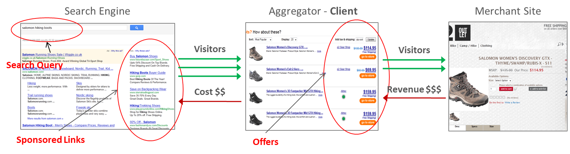
Context: High volume, velocity and variety clickstream data
BOTTLENECKS
SOLUTION
IMPACT
Business Model
Bottlenecks / Challenges in previous state
Dynamic: Keyword “worth” changes by the day, necessitating solution that can dynamically predict bids
Volume: 500 million keywords, billions of daily clicks, 3 geographies, 11 web properties
Process: Manual and inconsistent process increases business risk

Slide 33



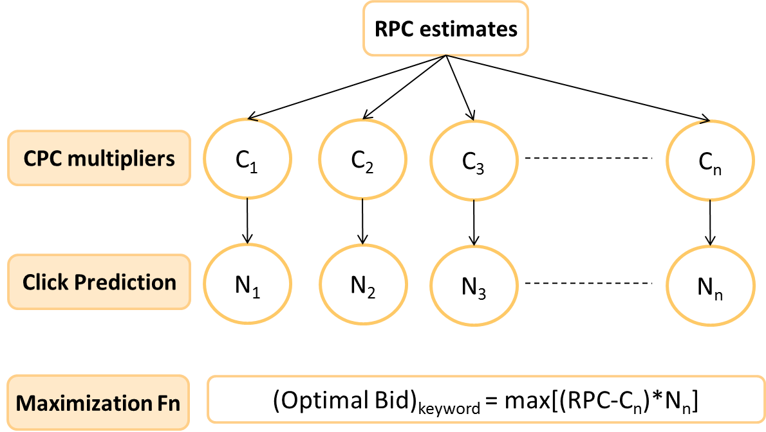


Leveraging the right modeling techniques
BOTTLENECKS
SOLUTION
IMPACT
Solution Framework
Input for every Keyword
Decompose RPC into Granular Modeling Entities
Estimate Revenue per Click for every keyword
Build models with transactional and non-transactional data
Historical Performance
Random
Forest
Neural Networks
Gradient Boosting
Inventory landscape details
Transactional
Variable Weight
Non -Transactional
Search Algorithms’ Diagnostics
Clicks
Multiple parameter variations for each Technique
Semantics

Slide 34
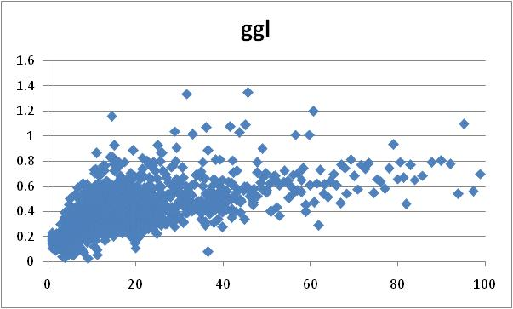
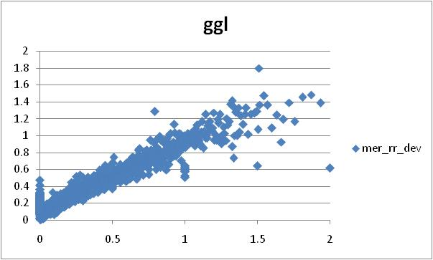
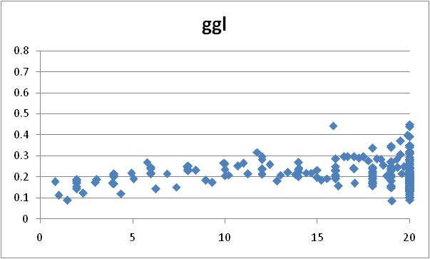
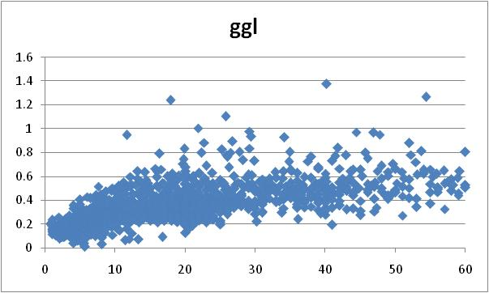
Synthesizing predictors by understanding data relationships
BOTTLENECKS
SOLUTION
IMPACT
Offer
Landscape
Transactional
Delphi 3.0
OFFER_PER_ATOM
MERCHANT_RR_HIST_16W
Semantics
Synthesized
Bid
Landscape
Search
PAYING_RESULTS
OFFER_PER_CID

Slide 35
Modeling process that integrates entire portfolio
BOTTLENECKS
SOLUTION
IMPACT
Total RPC
MER_RPC
SL_RPC
MER_RR
MER_RPR
SL_RR
SL_RPR
CLICKS_Hist_16W (x)
x= 0
1 <= x < 5
5 <= x < 10
10 <= x < 100
NT
LT
MT
HT
Segment wise modeling
RF (4)
GBM (2)
NNET (12)
Ensemble
Estimates

Slide 36
Modeling process that integrates entire portfolio
BOTTLENECKS
SOLUTION
IMPACT
SEMPRO
NT
LT
MT
HT
Estimates
Target Margin
Capping
Cutlist
Search Engine
specific configuration
Final Bids

Slide 37
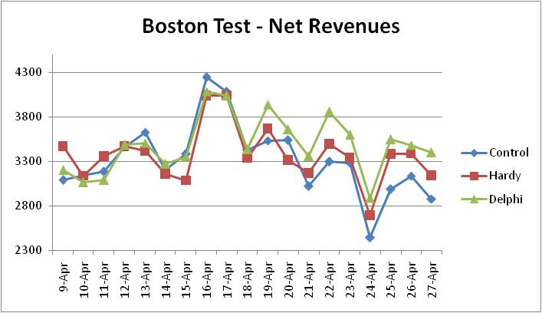
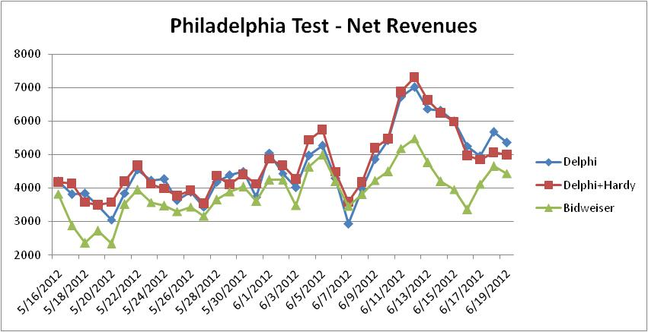
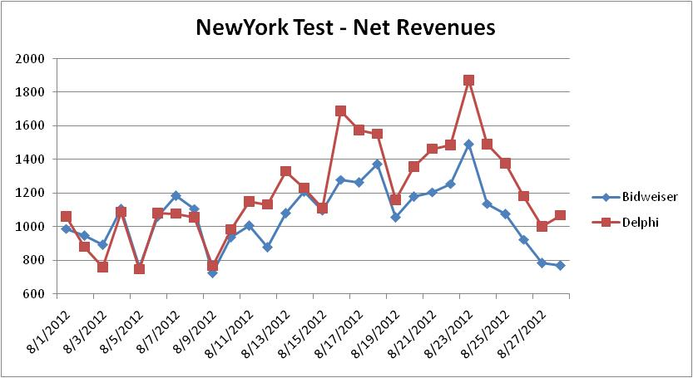
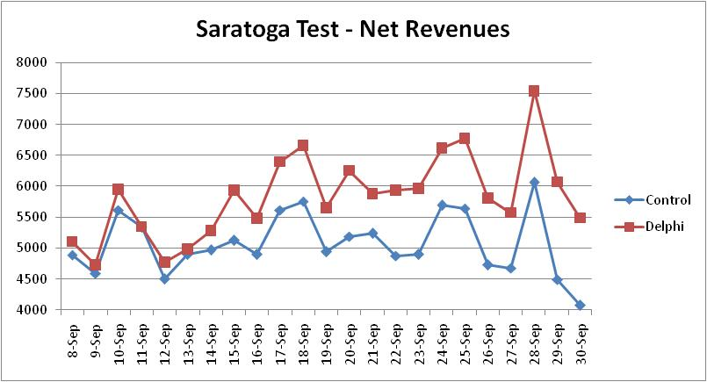
Robust A/B testing to validate results
BOTTLENECKS
SOLUTION
IMPACT
Delphi beats control by 5%
Delphi beats bidwiser by 18%
Delphi beats bidwiser by 13%
Delphi beats control by 15%

Slide 38



Leveraging an industrial scheduler to manage process
BOTTLENECKS
SOLUTION
IMPACT
Optimized operational time
Currently sequential and dependent
Completely Automated and scheduled
PX_FR
Data Extraction PX_FR
LP_UK
Data Extraction LP_UK
SD_DE
Data Transformation PX_FR
Data Extraction SZ_FR
SZ_FR
Data Transformation LP_UK
Data Extraction SD_DE
Data Aggregation PX_FR
Data Transformation SZ_FR
Data Aggregation LP_UK
Data Transformation SD_DE
Scoring PX_FR
Data Aggregation SZ_FR
Scoring LP_UK
Data Aggregation SD_DE
Bidding PX_FR
Scoring SZ_FR
Bidding LP_UK
Scoring SD_DE
Bidding SZ_FR
Bidding SD_DE

Slide 39
Summary of Solution
BOTTLENECKS
SOLUTION
IMPACT
Solution Summary View
Predictive Modelling Engine
Ensembles of neural networks, gradient boosting, random forests (1.5k models)
Models for different properties, segments, covariates vs factors
Keyword Bidding
High, medium, low volume bids
Activating archived and very low volume keywords
For various properties across geographies
Click-stream
Landing Page
Product Attributes
Scoring Engine
Score data every few hours
Scores deployed by property, type of keywords, experiment groups
Test & Learn Experimentation
Continuous testing and changing of bids through experiment design
Contests to evaluate various bidding strategies by controlling several factors
PPC Attributes
Offers
Model Lifecycle Management
Hyper parameter tuning
Track model performance metrics
Evaluate shelf life of models
Reporting & Insights
Executive Reporting
Analytical Reporting
Operational Reporting
Data Sources
Data Mart
Advanced Analytics Engine
Decision Management

Slide 40


High impact on net revenue and bidding process
BOTTLENECKS
SOLUTION
IMPACT
Impact
Revenue Lift
`Granular Daily Changes to Bids
The automated bidding platform provided a 20% lift in terms of net revenue, with over $10Mn in the first year
Complete Automation of the bidding process enabled daily refreshes of the bid values incorporating feedback from previous day bids

Slide 41
Snapshot of Select Projects Advanced Analytics

Slide 42


Snapshot of select projects : Advanced Analytics
Other client projects involving advanced analytical techniques
By utilizing the historical power consumption data of data centres and data around the customers of the client, LatentView was able to provide accurate power consumption forecasts which is key in making the “Hedge” successful
Regularized random forests & the “SVD + Univariate Forecasts” combined to improve forecast accuracy
Potential Savings between 1- 5 Million
Utilized text analytics techniques to extract behavioral data which was combined with structured data like service logs to generate predictions on each SR turning critical
Early Warning System (EWS) with over 95% accuracy in predicting critical SRs
Saved the client $ 20 million per quarter
Identified key factors influencing PTB sales using Bayesian models, prioritized markets based on customer propensity and provided a self-service scenario analyzer tool to optimize resource allocation
Go/No-Go decision timeline for new product launches was cut by half
‘Go’ decisions taken were far more resilient to market dynamics as it addressed the root causes

Slide 43
Leveraging Unconventional Data for Business Insights

Slide 44
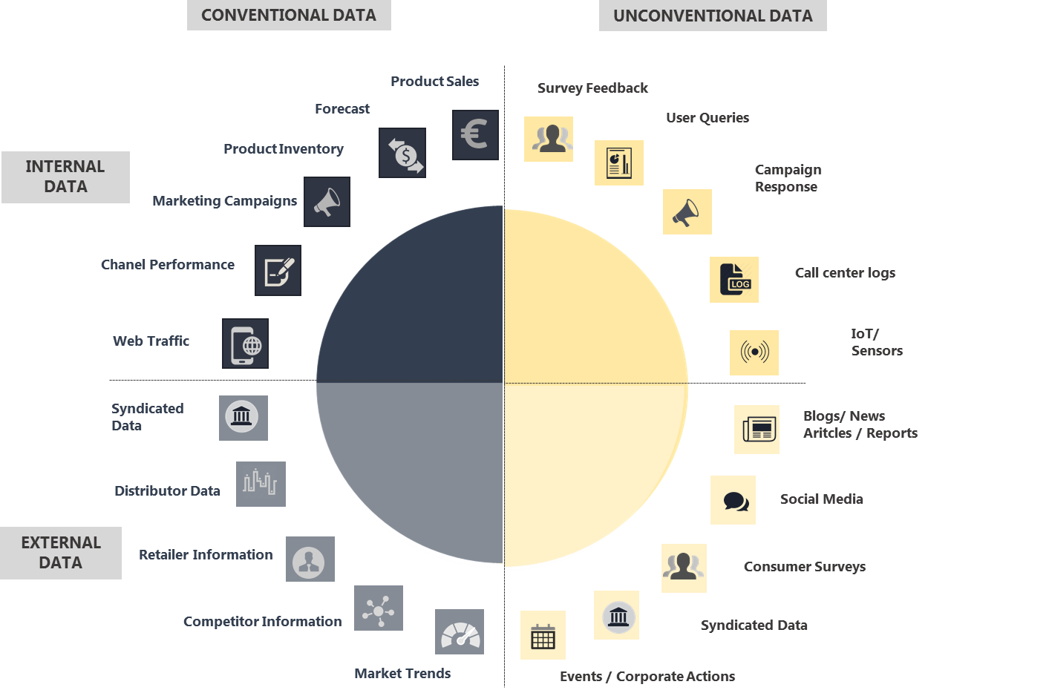
Leveraging Unconventional Data for Business Insights
Significance of combining data sources
INSIGHTS
Faster
Less time lag between activation and insight generation
Brand and competitive perception tracking through social text mining
Understanding of product usage by consumers leading to better product design and marketing
Voice of consumer analysis of community, customer service and social conversations providing insights into emerging trends
Contextual analysis of community and social conversations providing insights into functional and emotional needs of the consumers
Cost Effective
Customer feedback data & social data are easy to obtain and help in cost reduction
Granular
In-depth understanding of customer behaviour & preferences
Quantum
Large number of data points are available
Natural
Listen to large number of unsolicited responses; no boundaries

Slide 45
Case Study in Detail: Whirlpool Innovation Radar

Slide 46







Innovation Radar: Key Highlights
Expert and Customer Review Data pulled from over
39 websites
Over
9 million reviews analysed
Review data across 580 brands
Data collated from
3 regions & 5 languages
2500 users across the firm using the tool
16 Dashboards
9 Analysis

Slide 47












Innovation Radar: How it happens
Data Extraction
Text Analytics
Visualization
Sentiment Analysis
Industry Forums
Senior Executive
Drivers of Purchase
Region
Category
Consumer Reports
Triggers of Purchase
Deep Dive
Market Places
Expert Opinion
Category
Comparison
Platform
SKU
Homedepot
Amazon
AO
Lowes
Consumer Rating
Brand X vs. Competitors
Brand Websites
Popular Features
Category
Comparison
Platform
SKU
LG
Samsung
Brand A
Brand B
Trend Analysis
BeautifulSoup --- Gensim, Stanford NLP --- AngularJS, d3JS

Slide 48
Product Development & Excellence – Top Loading Washing Machine
1
How is Customer feedback of Brand A Top Load Washers compared to other brands ?
2
How is Customer feedback of Brand A Top Load Washers within commercial segments compared to other brands ?
Deep Dive on SKU 1 Performance :
What is the overall Customer Rating for the product ?
What are the opportunities for innovation ?
How was each component of the product received and customer sentiment ?
3
4
Compare against competitor products under the same segment
How is the Customer Rating compared to competitor products in the same segment ?
What are the key areas of Innovation compared to competitor products ?

Slide 49
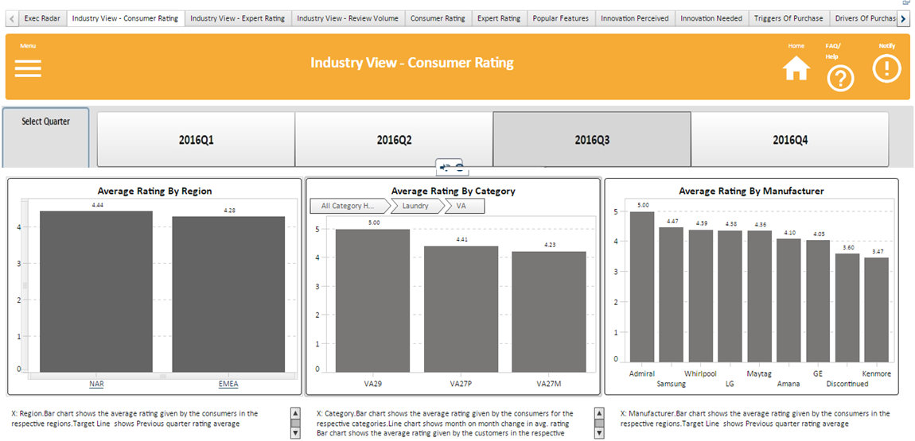
How is customer feedback of Brand A Top Load Washers compared to other brands ?
Brand A is the best brand in top load washers
Brand A & Samsung has higher rating in Ease of Use & Design when compared to Brand B
Brand A
Brand B
Brand C
Brand E
Brand H
Brand D
Brand F

Slide 50
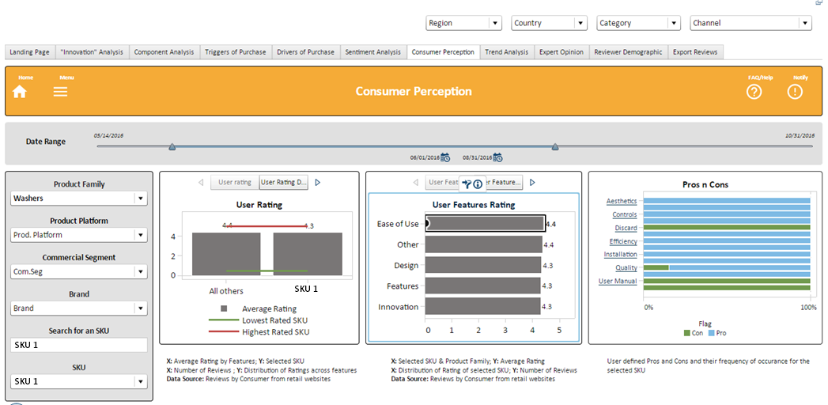
What is the overall Customer Rating for the product ?
SKU 1 was appreciated for its Ease of Use

Slide 51
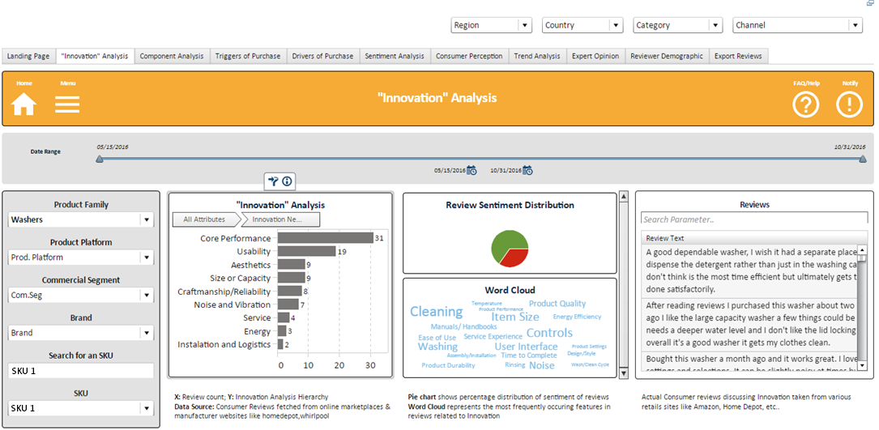
What are the opportunities for innovation ?
For SKU 1, Consumers felt there is opportunity for future innovation in core performance especially by having a faster wash cycle

Slide 52
Snapshot of Select Projects Data Driven Innovation

Slide 53



Snapshot of select projects: Data Driven Innovation
Other client projects using data to drive innovation
Built a web based data scraping, NLP and visualization platform using Octoparse, Python and MEAN stack on AWS technology to collect and visualize funding, user comments data from crowdfunding sites
An actionable list of early stage start-ups
Periodic monitoring by M&A team to evaluate the start-ups
Begun partnership or acquisition talks 1-2 years before mainstream acceptance
Social media conversations were mined to identify emerging flavors and the underlying emotional and functional drivers associated with them
Reduced innovation cycle time by 1.5x
Identified 20 flavors at a fraction of ideation cost
Gained a big first-mover advantage
Catalogued a list of all bread/muffin varieties & mined relevant social conversations to identify emerging flavors / ingredients and their associated drivers (emotional, functional)
Reduced time to market by 2x,
Identified emerging trends early on
Catered to consumer emotions and excitement
Increasing product overall sales and ticket sizes

Slide 54
Thank You!
www.LatentView.com
| Princeton | San Jose | Seattle | London |
Chennai | Singapore |

Slide 55

Case Study in Detail: Sysco Gravity
Appendix

Slide 56

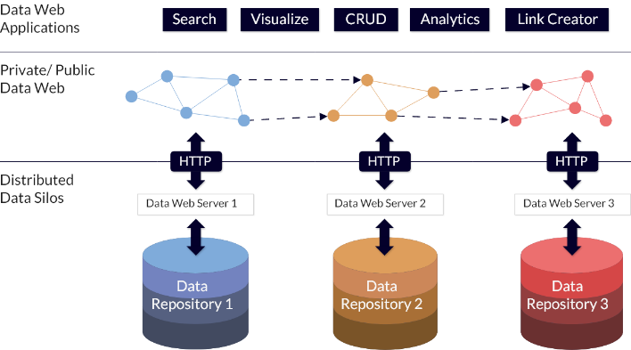
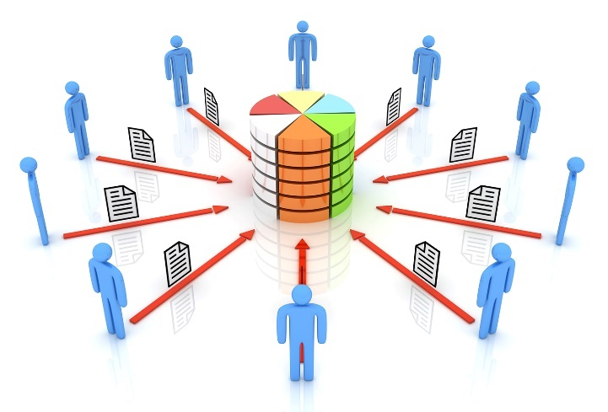

Sysco Gravity: Data Engineering
BOTTLENECKS
SOLUTION
IMPACT
Bottlenecks in previous state
Lack of Central Data Repository resulted in following concerns:
Delays in accessing and analysing data
Legacy Ageing Business Analytics Infrastructure
Data Discovery is Difficult
Difficult to Handle Large Volumes of Data for Analytics
Constraints due to Total Cost of Storage
Siloed Data Systems
vs.
Centralized Data Repository

Slide 57
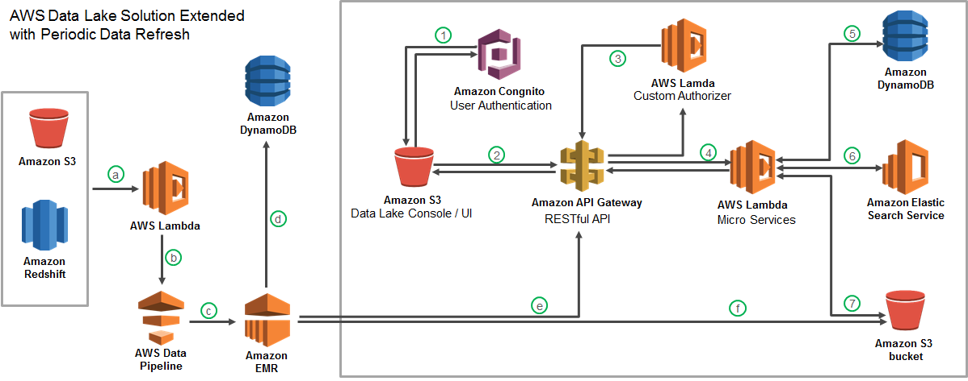
Sysco Gravity: Data Engineering
BOTTLENECKS
SOLUTION
IMPACT
Solution Framework
Migrated 60TB of data from legacy systems into a cloud based data lake with extended periodic data refresh which supports reporting and advanced analytics solutions
Data Migration

Slide 58



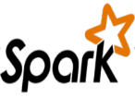



Sysco Gravity: Data Engineering
BOTTLENECKS
SOLUTION
IMPACT
Impact
Data Platform
Analytics Use Cases
Enabled different Analytics Use Cases like
Always Open Repository
Recommendation Engine
Advanced Analytics ML pipelines (Product Recommendation Engine - Already deployed)
Reporting out of Redshift spectrum Adhoc analysis in Athena (For Price Migration Tool)
Netezza
Legacy System
Discoverable Data Sets for end users
Amazon S3
Distributed Processing
Order Anomaly Detection
Centralized Data Repository
Cost Effective
Automated scaling up/down based on requirement
PySpark + S3
Product Substitution
Optimized Data Storage – Parquet, Gzip, etc.
Revenue Management
Reusable & Configurable components
RedShift
The gravity module is reused in other systems where data migration is done across different systems
Enterprise Reporting Platform

Slide 59




Sysco: Product Recommendation Engine
BOTTLENECKS
SOLUTION
IMPACT
Bottlenecks in previous state
Gut Based Product Recommendations
Information Asymmetry - Sales personnel lacked information on possible product recommendations and substitutions
Multi-Unit Customers – Account executives, personalized recommendations to some extent
Low Margin Products - Recommendations were based on limited set of products sales agent is aware of and is often the not profitable low margin products
Local Contract / Street Customers – Marketing Associates, very little analysis & personalization
Lack of visibility into changing demand of customers – Lack of analytics on transaction data resulting in weaker insights about customer needs

Slide 60



Sysco: Product Recommendation Engine
BOTTLENECKS
SOLUTION
IMPACT
Solution Framework
Collaborative Filtering
Market Basket Analysis
Items Purchased:
Market Basket Analysis performed for all products bought by customers in a segment. Select the product with highest likelihood to co-occur in the basket
Items Purchased:
Similar
Customer B
Milk
Eggs
Bread
MILK | EGGS | OLIVES | BREAD
Milk
Eggs
Customer A
TRX1
Customer C
Milk
Eggs
TRX2
Recommend Bread
TRX3
Recommended
Bread
User-User Similarity - Similarity is calculated between customers within a segment based on common products in basket using Cosine Similarity
TRX4
Recommendation Engine
Combine the recommendations from the 2 algorithms to generate the final recommendation
For a Customer who purchases Milk & Eggs, the product with highest affinity is Bread

Slide 61



Sysco: Product Recommendation Engine
BOTTLENECKS
SOLUTION
IMPACT
Impact
Real time recommendations
Easier Conversions
Real time recommendation to assist the Marketing Associates to make better decisions
Sales Team has data based insights which make it easier to sell new products to customers
Increased Sales
Customer Satisfaction
20% increase in value of new orders from existing customers
Higher customer satisfaction due to precise recommendations

Slide 62
Case Study in Detail: BMW Warranty Claims
Appendix

Slide 63
LANDSCAPE
PROJECT GOAL
IDENTIFY DRIVERS
ANALYTICS SOLUTION
IMPACT
RESULT
Issues followed patterns with product usage
Long Product Development Cycle
High cost & No. of warranty claims
Opportunity to prevent issues/reduce costs
Landscape
Goal
Develop a systematic, faster & automated hypothesis testing platform to understand vehicle usage patterns & manage risks
Business Process
Product Design & Testing
Post Sales Service & Maintenance, CRM
Risk Assessment & Warranty Claims
Connect Product Usage with Warranty
Repairs & Failures
Predicting Risk For Similar Profiles
Identify Drivers
Driving Styles
Identify key driving styles using the vehicle controller data
Warranty Claims and Automated Hypothesis Testing
Compare driving styles with warranty claims data. Use the tool to identify risk groups by dynamic profiling
Analytics Powered Solutions
Cross functional & Cross BU interests in potential business cases
90% of risky neighbors to warranty claimed cars were identified
Impact

Slide 64
Product Design & Testing using Behavior Modeling
BOTTLENECKS
SOLUTION
IMPACT
Bottlenecks in previous state
Limited View of Different Driving Styles
Drive Fast, Assertive (such as confidently overtaking cars), confident when it comes to the likes of corners and turns, or do you bring the car to a much slower speed to be safe
Linkages between Vehicle Usage and Failures not clearly understood
Combining functional universes of warranty data & vehicle data
Limited View of Different Driving Purpose
Taxi Drivers , City Drivers, Countryside Drivers, Sports Drivers etc.
Effect / Interaction of Car Characteristics on Driving Styles not studied
Automatic transmission, Manual transmission, BHP , Torque

Slide 65





Product Design & Testing using Behavior Modeling
BOTTLENECKS
SOLUTION
IMPACT
Solution Framework
Driving styles were identified based on vehicle usage and historical warranty claims
Car Universe
Majority of these cars are police cars
Vehicle Usage from Connected Data
Driving Styles
Speed, Acceleration,
Longitudinal movement, Trip Length, Pause Duration, Temperature etc.
100%
High Pedal Position
90%
High Speed RPM
55%
High Speed Low Torque
Time spent compared to average driver
Time spent compared to average driver
Time spent compared to average driver

Slide 66



Product Design & Testing using Behavior Modeling
BOTTLENECKS
SOLUTION
IMPACT
Impact
Improved Customer Segmentation
Portfolio Strategy
Insights about how do customers drive different vehicles. For e.g. how do customer drive Hybrid and Electric vehicles
Customer were segmented based on their driving behavior
Engine Development &Testing
Component Evaluation
Are we using right product at right situation and for right customer. For e.g. do we offer proper cooling systems in different climate zones?
Insights around technical parts of the car. For e.g. does short trips between long pauses increase warranty claims?

Slide 67
Preventive Maintenance & Warranty Claims
BOTTLENECKS
SOLUTION
IMPACT
Bottlenecks in previous state
What was happening?
High cost & No. of warranty claims
Issues followed patterns with product usage-Typical patterns at Market/Model/Customer levels
Opportunity to prevent issues/reduce costs- If identified at actionable early stage
Long product development cycle- Requires data driven business cases for actions

Slide 68

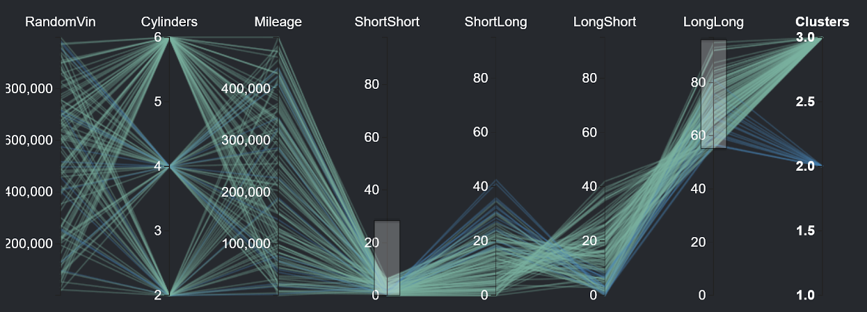

Preventive Maintenance & Warranty Claims
BOTTLENECKS
SOLUTION
IMPACT
Solution Framework
Controller Readout Data
Hypothesis Testing Tool
1. Unique Vehicles
“There seems to be a pattern with these 50 VIN Numbers”
2. Unique Issues
“What is causing Head Gasket failure? ”
3. Hypothesis
“Valves (VVT) damage when driven in consistent low speeds”
Output
Clusters Patterns
Usage Characteristics
Potential Risk (€)
Risks is neighboring clusters
Possible Root causes
C1 – > 30K/Yr, 30% Long Trips, 25% - Acceleration > 200KMPH
Typical Issues:
Head Gasket Failure, Soot in the oil, Engine mount issues
Calculated Risk: €2.400,00
Risky Clusters: C2, C6
Cause: High Acceleration in winter without heating
Warranty Data
Total Claims
Claim types & Sub types
Parts replaced
Warranty Cost

Slide 69

Preventive Maintenance & Warranty Claims
BOTTLENECKS
SOLUTION
IMPACT
Impact
Vehicle Usage – Warranty Connect
Warranty claim analysis
Provides a better understanding of Vehicle usage profiles & correlation with Warranty claims
Speeds up Warranty claim analysis, (compared to highly time consuming manual analysis) – On the fly analysis is now possible
Preventive Maintenance
Risky Drivers Identified
90% of the risky drivers exhibiting driving styles similar to warranty claimed cars were identified and Proactive ‘drive right’ messaging communicated to at-risk drivers
At risk drivers were provided with preventive maintenance to pre-empt engine or parts failures saving up to 35% in warranty costs

Slide 70
Case Study in Snapshots
Data Engineering
Appendix

Slide 71




High Volume ClickStream Analytics to Monetize Search Page Ads
American Multinational Technology Giant
The Problem: Client’s revenue per user in finance was 25% lower than revenue per user for travel related searches
The “Before” State
LatentView Solution
The “After” State
i
Average revenue per click per user for financial stock related search terms was 30% lower for our client’s search engine as compared to competitor
Built a high volume, high throughput clickstream data pipeline that combined demographics, search and browsing data to suggest the right ads and its placement to improve customer experience
Relevant ad impressions on financial stock searches increased by 33% which combined with a 5% increase in click through rate resulted in an additional monetization opportunity of $15 million annually
Convert unstructured data to structured data
Scalability – capable of processing 1 TB in 24 hours
Cost Effective – Optimized to reduce infrastructure cost
Competitor Analysis – comparison of features and click through rate between Client and Competitor
Products Catalog, Coverage & Click through rate
Form Factor & Browser Influence on consumer behavior
User Switching – Identify factors influencing user switching between Client and Competitor
Analysis
←
Clickstream Analysis
11
Notes:
Microsoft Panel Miner
Business Objective:
Help identify signals that influence the whole user search experience and also increase the user engagement on client’s search engine
LatentView Solution:
LatentView’s Panel Miner solution was applied to convert unstructured HTML data to structured tabular data
LV’s seamless data processing pipeline is composed of ETL operations followed by Hadoop processing and finally migration to database for storage and reporting
Over 300 GB per week of data is hosted in AWS cloud environment
Web dashboards and automated Excel reports were built for reporting of outputs
Business Benefit:
Weekly reports on the feature coverage, feature distribution, CTR(Click Through Rates) of search result pages along with competition to benchmark key performance differentiators
Weekly news flash on new features introduced by competition, their Ad footprint to measure key performance indicators such as ad density, ad impression yield that can influence decisions taken by Product Planning Group.
Deep dive analysis of Click Stream data to infer users position in purchase funnel and thereby identify signals
Selected for Presentation in AWS Re-Invent-2014
For 4.5M searches per month, with 12% of them clicking through to brokerage sites, assuming an ad revenue of $1 - $6 per click, potential monetization benefit realized is between $3M to $18M annually

Slide 72












Data Harmonization for Efficient Digital Supply Chain
Data Harmonization for Efficient Digital Supply Chain
World’s Largest Entertainment production company
The Problem:
For digital content that contributes $4 billion in revenue, the weak link in the supply chain is the nature of data pipeline which in the correct state is rigid & fragmented
The “Before” State
LatentView Solution
The “After” State
The supply chain starting from digital content request to going live is tracked using multiple silo data sources and requires skilled executives to monitor for revenue leaks
Built an data ecosystem from multiple disjointed unstructured and structured data sources by leveraging AWS cloud platform for big data, thus providing a monitoring platform
The solution helped in ensuring on-time delivery of the digital contents and thus, saved half a million dollar per year from revenue leaks
SQL Server
DMS
(ongoing replication)
S3 buckets
(encrypted)
Redshift
MarkLogic
GLUE
Tableau Server
Internet
←
Azure
Lambda
EC2 (Bastion Host)
DBA

Slide 73


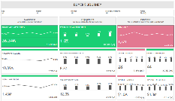



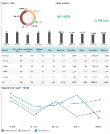
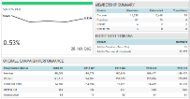



Design & Develop an Enterprise Level Marketing Framework
Key Digital Trends in the Auto Industry
The Problem: Lack of unified view on marketing KPIs across multiple business functions prevents large organizations from “swimming the same direction” towards enterprise goals
The “Before” State
LatentView Solution
The “After” State
Client’s marketing reports required manual intervention, offered limited perspective and were generated from various sources of data creating multiple versions of truth
Assessed & Redesigned the Marketing KPIs inline with client’s business objectives using LatentView’s proprietary digital marketing measurement model
Real time dashboards offered unified view on marketing efforts across the organization resulting in more accurate measurement of spends & related business outcomes
UNDERSTANDING LANDSCAPE
REFINING KPIs
DESIGNING WIREFRAMES
Business Objectives
HDS Marketing Operations
Demand Gen
Field& Tele Marketing
Partner Marketing
Digital Marketing
Social/AR PR
Content Marketing
Community
Goals, KPI’s and Targets
Segments
Gap Analysis
←
Notes:
Hitachi Data Systems – Marketing Framework Consulting
Business Objective:
Client’s current marketing analytics environment, consisting of a number of reports delivered to various stakeholders, has the following limitations:
Manual effort required to generate dashboards
Dashboards offering limited perspective
Multiple sources of data providing multiple versions of truth
LV Solution:
The approach followed by LatentView for refining HDS reporting structure:
Audit Current Reports & Refine KPI’s: Identify gaps in KPIs & segments in the context of current reports; Understand data sources, data flows; User interviews; Identify business objectives; Define KPI’s required vs used leveraging Digital Measurement Model (S.M.A.R.T KPI Framework)
Design Wireframes: Understand detailed wireframe requirements; Iterate on wireframes and review with potential end users; Prioritize wireframes based on business needs and complexity of implementation; Beckon’s Formatting for increased readability of wireframes
Data Integration: Define architecture for the data integration layer; Design the data model for the analysis data mart; Recommendations on Data Integration process for report deployment on Pentaho
Business Benefits
Refined KPI framework that aligns with the business goals and targets
Visually insightful wireframes that will be implemented as dashboards to drive business decisions
Detailed data model and data flow for implementation of the wireframes
Future analytics road map laid out based on the data model, for better understanding of the business to help drive successful business decisions

Slide 74
Case Study in Snapshots
Optimization
Appendix

Slide 75
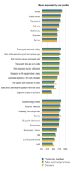

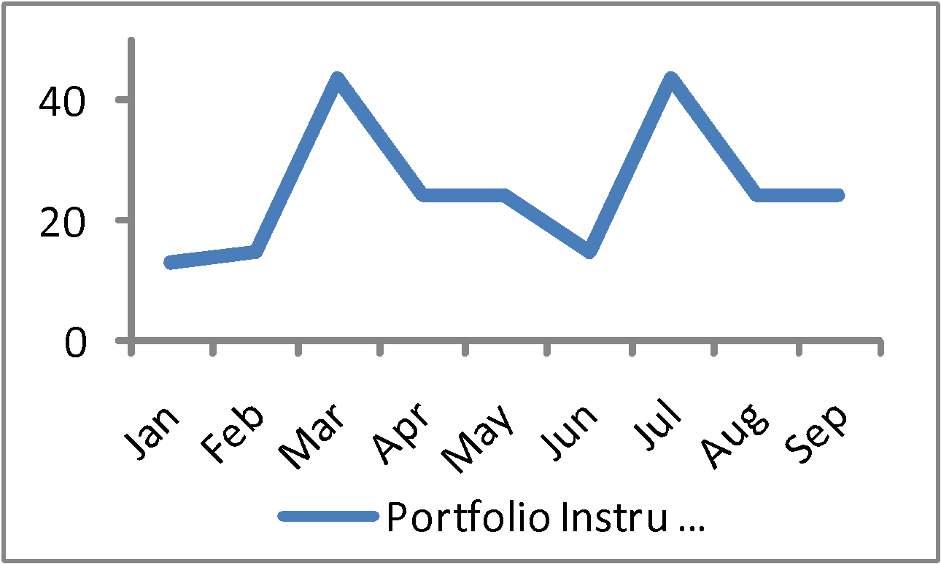
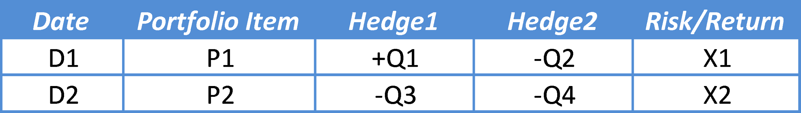
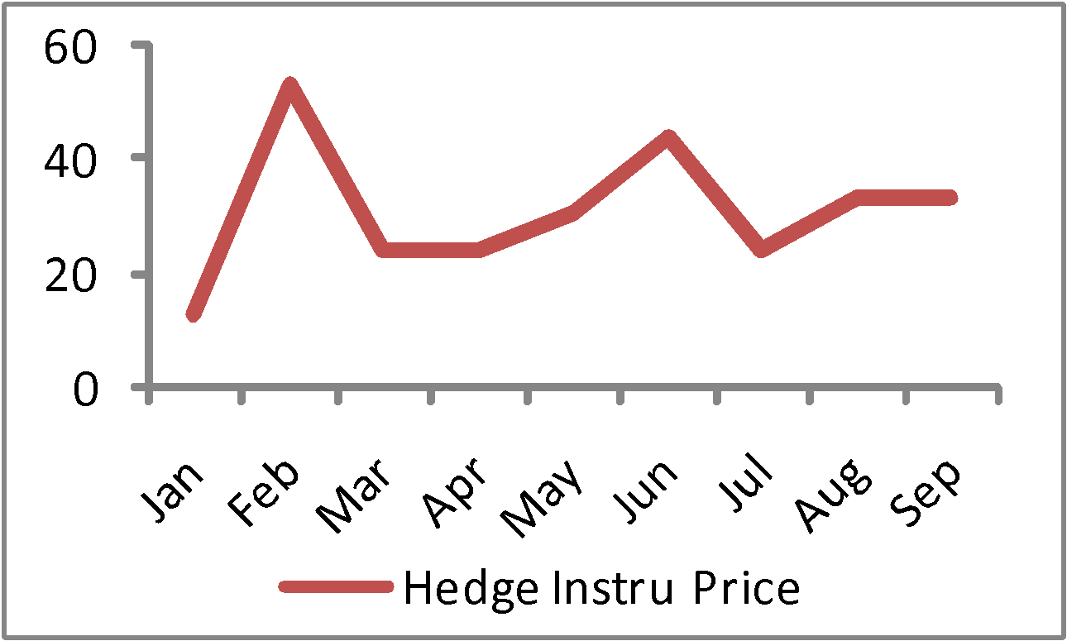
Risk Optimization to Hedge Volatility in Crude Oil Prices
Leading integrated supplier of marine fuel products
The Problem:
For oil trading companies, risk management is the difference between profitable and not profitable operations
The “Before” State
Latentview Solution
The “After” State
No data driven approach to forecasting oil prices and quantifying risk, which meant that the hedging strategy was not optimized
Developed a robust risk management strategy to account for the high levels of volatility in the crude oil market using price forecasting models on both the portfolio bunker indices and hedge instruments followed by Non-linear optimization framework to arrive at an optimal hedging strategy
Robust hedging strategy operationalized that maximized returns while minimizing portfolio risks
Enabled the client answer quantitatively:
What is the amount of risk in the portfolio?
What instruments should be used for hedge and in which direction?
How much of the portfolio should be hedged?
Quantifying the risk in the inventory
Multivariate profiling
Output
Non-linear Optimization
Price prediction of portfolio items
Portfolio of Items in Inventory
Optimal Hedging Strategy
Time series model
←
Price prediction of hedging instruments
Notes:
Chemoil – Trading Analytics
Business Objective:
Develop a robust risk management strategy to account for the high levels of volatility in the crude oil market
Validate existing hypotheses around the relationships between various portfolio indices and its corresponding hedge instruments
LatentView’s Solution:
Price forecasting models using time series techniques were developed on both the portfolio indices and hedging instruments.
Quantification of portfolio risk based on profiling the historical inventory data for average depletion rates/day by portfolio indices
Non-linear optimization framework that combines the price predictions with the risk quantification to arrive at an optimal hedging strategy that minimized the portfolio risk while maximizing its returns
Business Benefits:
Robust hedging strategy that maximizes returns while minimizing portfolio risks
Enabled the client answer quantitatively:
What is the amount of risk carried in the portfolio?
What instruments should be used for the hedge and in which direction?
How much of the portfolio should be hedged for maximum returns?

Slide 76
Amplifying profit by Optimizing Bid Rates for ‘First spots’
Leading Travel Website
The Problem: In the OTA industry, securing first spots on travel aggregator sites at optimal rates has big impact on overall profitability
The “Before” State
LatentView Solution
The “After” State
Bidding rates set manually based on intuitions & experience led to either expensive over-bidding or underbidding which reduced transaction volumes by 50% in half of the major markets upon drop in bid spot
Developed a tool which analyzed the number of quoters, transactions and purchase rates at days to arrival level for each city to forecast the most optimized bids for ‘first spots’ on travel aggregator websites
Net annual financial impact of $532k with the aid of cost reduction (optimized bids) of $204k and increase in transactions (higher first spot ad placements) of $328k
Automated Forecasting
Revised Bids for Top Markets
X: Average of Historical Bids Y: Actual First Spot Bid Z: Forecasted Bid
Z: 0.54 < X: 1.2 < Y: 2.09 → Revised Bid = 2.09
Z: 2.73 < X: 5.27 = Y: 5.27 → Revised Bid = 2.73
SAMPLE USE CASE
X: Average CPC; Y: First Spot Bid; Z: Breakeven CPC
Past
Quoters
Past Txns
31 Cities
(21 Standalone & 10 Clusters)
4 Days to Arrival
Buckets
Alpha
Past Purchase
Rate
$ 328 k
$ 204 k
Cost Savings (Optimized Bids)
Incremental Revenue (Better Ad Spots)
←
Forecasted Quoters, Transactions,
Purchase Rate
$ 532 k
76
Total Savings
Notes:
Hotwire- OPM bidding
Business Objective:
Minimize the bidding cost to reduce advertisement cost and higher conversion rate by getting the first spots.
LatentView Solution:
K-means clustering was used and 2,514 cities were put under 10 clusters.
Entire Forecasting process which uses exponential smoothing is automated and acts a tool for prediction.
This tool iterates through every city at each DTA(Days to arrival) level and does prediction for the upcoming week
We get the forecasted Quoters, Txns and PR as a result and the tool also calculates the breakeven CPC for each City * DTA combination.
Quoters : No. of people who will hit the hotwire site
Transaction : No. of people who transit on hotwire after redirecting
Purchase Rate : Transaction/Quoters

Slide 77


Maximize Business Value using Optimization and Personalization
US Based Retail Corporation
The Problem: For maximizing value for all the stakeholders, identifying right customer with the right offer through right channel
The “Before” State
Challenges
LatentView Solution
Offers on the web page and email based direct marketing was based on category-based propensity models built using historical data
Millions of customers across segments
100s of webpages & 100s of Email Layouts
1.7M+ Products & Services with 10K+ Offers
Optimization algorithm runs into several minutes for each customer
Developing a dynamic offer personalization and evaluation mechanism which helps in estimating conversion probability and value
Optimizing based on offer display and merchandising constraints
Customer Clusters
Lifecycle Map across Product Categories for each Customer
Identify Cluster
C1
C2
 | Office Supplies | Tech | Furniture | Cleaning | Break-room | Mail & Ship | Copy & Print
Reactivate
Retain
Grow
Activate
New
Customer Attributes
Customer Type
Company Size
Industry Vertical
C3
C4
Location(s)
Membership Age
C5
Relevant Offer Types
Mapping customer to relevant Segment and Lifecycle Stage for each category reduces the number of relevant offers and products for a customer
←

Slide 78
Case Study in Snapshots
Advanced Analytics
Appendix

Slide 79
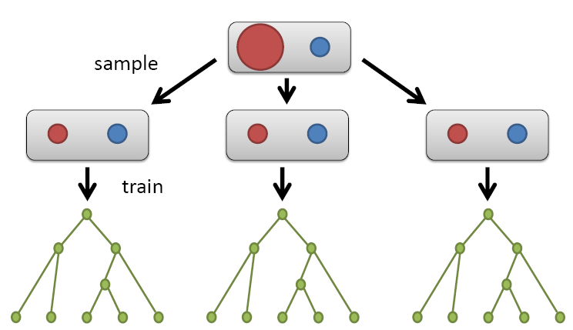
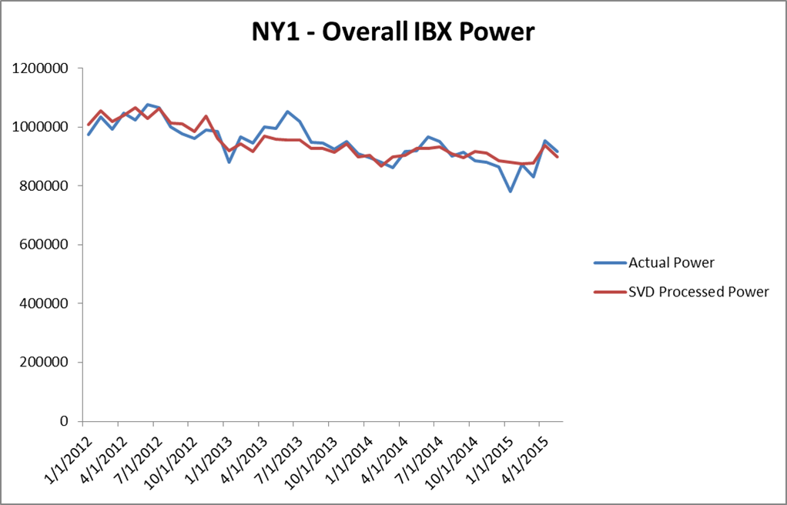
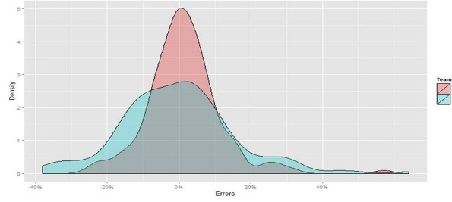

Accurate Power Consumption Forecasting for Successful Hedging
Leading Global Technology Infrastructure Provider
The Problem: Customer Lifetime Value of existing customers is nearly twice that of new customers and hence retention is key to profitability
The “Before” State
LatentView Solution
The “After” State
Power Consumption at its data centres is the largest operational expense for the client
And low accuracy of existing power forecasts led to expensive power prices
By utilizing the historical power consumption data of data centres and data around the customers of the client, provided accurate power consumption forecasts which is key in making the “Hedge” successful
Regularized random forests & the “SVD + Univariate Forecasts” combined to improve forecast accuracy enabling potential Savings between 1- 5 Million
Overall Data
Center Power
Regularized Random Forests
Predicted Customer Power
Historically learnt
Overhead Power
Forecasted Overall
IBX Power
Customer Power Data
Overhead Power
Customer features |  |  |  | Customer Power (Historical)
+
=
+
Customer Power
Singular Value Decomposition
Actual Power
SVD Processed Power
LatentView
Existing Solution
←
Distribution of Forecast Errors

Slide 80






Early Warning System to Enhance Customer Satisfaction
Fortune 500 Technology Hardware Company
The Problem: In the hardware services space, preventive maintenance is 40-45% cheaper than ‘after the event’ corrections, but to prevent, one needs to precisely predict service requests (SRs) that can turn critical
The “Before” State
LatentView Solution
The “After” State
Account Managers through manual inspection flag critical SRs which lead to errors and person dependent situation
Utilized text analytics techniques to extract behavioral data which was combined with structured data like service logs to generate predictions on each SR turning critical
Early Warning System (EWS) with over 95% accuracy in predicting critical SRs saved the client $ 20 million per quarter
Keyword Extraction
Supervised
Learning
Part of Speech Tagging
Critical SR probability = 0.8
Unstructured Data
Structured Data
Pre-structured Data
Feature Tagging
Critical SR probability = 0.6
Log
Critical SR probability = 0.5
Sentiment & Theme Evaluation
←
Text Mining Framework
Analytical Approach
80
Notes:
Cisco - Early Warning System
Notes:
Business Objective:
A POC to build an Early Warning System (EWS) to predict the probability of an incoming service request (SR) turning CAP.
LatentView Solution:
Phase 1 - Data Profiling
Phase II - EWS – Model building for Structured Data
Phase III - EWS - Model for Unstructured Data
Finding Recommendations
Business Benefits:
Phase I - Nearly 90% of the SR’s raised had initial severity level 3 for the period of Jan-Mar 13’
Incidents with severity level 3 and resolved within 8 days and severity level 4 have a very low probability of turning CAP
The structured model captures 85% of the CAP SRs within 10% of the total SRs
Model with unstructured data captures 90% CAPs within 10% of SRs, whereas model with structured data captures only 85% CAPs
Model recommends that 5000 SRs should be serviced as potential cap SRs when 3 months of SR data are used for scoring
The overall benefit of servicing 5000 SRs recommended by the model would be around $30 Million

Slide 81
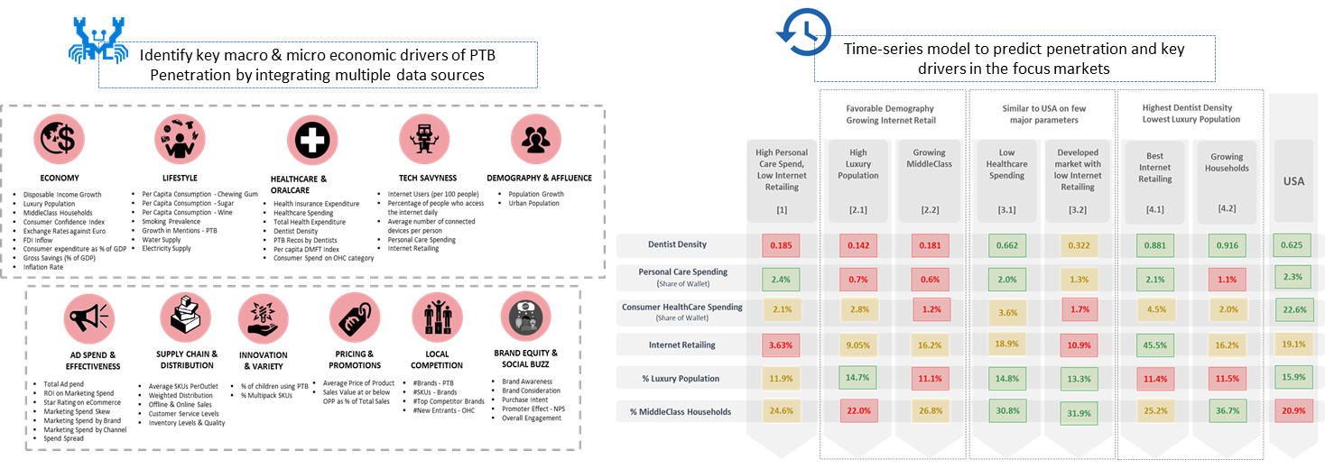
Analytics to Maximize Market Penetration for New Products Launch
Consumer Lifestyle Electronics Firm
The Problem: 60% of new product introductions in the consumer lifestyle space fail to take off due to wrong markets/positioning, resulting in losses running into billions of dollars
The “Before” State
LatentView Solution
The “After” State
Time-to-market was protracted as there was no scientific way in measuring expected success of new product launches
Identified key factors influencing PTB sales using Bayesian models, prioritized markets based on customer propensity and provided a self-service scenario analyzer tool to optimize resource allocation
Go/No-Go decision timeline for new product launches was cut by half and the ‘Go’ decisions taken were far more resilient to market dynamics as it addressed the root causes
←
81
Notes:
Philips Market Penetration Analysis
Business Objective:
Identify the key macro & micro drives of PTB penetration in five focus markets
Focus on existing markets and identify new markets for engagement at macro level
To allocate resources in individual markets based on the key micro drivers identified
LatentView Solution:
Identify key macro & micro drivers using Causal & Bayesian Models
Prioritize existing markets using Rank Order Algorithm
Identify & prioritize new markets using Cluster Analysis
Optimize resource allocation using Optimization Framework
Business Benefits:
Provide framework to prioritize existing markets and identify new markets using Cluster Dendogram
Optimize resource allocation within specific countries to maximise penetration
Create a comprehensive snapshot of the key drives that impact business goals

Slide 82

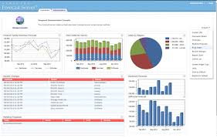
Media (Paid, Earned & Owned) Mix Modeling at Large Scale
Leading Home Appliances and Repair Services Provider
The Problem: Media mix spend effectiveness (revenue generated per dollar of spend) had declined by 5% for 2 consecutive years
The “Before” State
LatentView Solution
The “After” State
Media budget allocation was done on an aggregated, unoptimized basis and thus the cost per acquisition was much higher as compared to industry benchmarks
Created multi-variate linear models for paid channels and attribution models for non-paid channels which were further optimized at a product and channel level
By implementing the recommendations from the Media Mix Model (MMM), revenue increased by 1.9% for Home Repair and 2.3% for Home Improvement in a six-month period
Data Sources
Predictive Models
3 Business Units – HI, IHR & PD
Marketing Levels: Products (P) x Channels (C) x DMAs (D)
Paid Channels: Linear Models
Non-Paid Channels: Attribution Models
3546 Models built for BU1, 2376 Models built for BU2, 1218 Models built for BU3
Bing AdWords
Processed Data Marts
Google AdWords & Analytics
Ciboodle
Aggregated Weekly Data
Clustered Data
Omniture
Yahoo Adwords
Response Curves
Projecting the ‘Revenue - Growth Rate’ as a function of Cost in the form of ‘S Curve’.
Discovering the ‘Optimal Range’ of Spend Limits
←
POS
Meta Data @ Zip Code & Daily
Optimization Tool
82
Notes:
Sears – Media Mix Modelling
Business Objective:
Analytical solution to develop a media strategy in the digital space. The repair market was the key target area
The objective was to optimize marketing spend by allocating dollars to different marketing channels in order to maximize revenue.
LatentView Solution:
LatentView built a regression model for different channels using clicks as IDV to determine the equation that best defines the relation
The Solution included finding optimized spends across all channels
The data was then analyzed and various Key insights and recommendations were presented
Business Benefits:
The Marketing team could use the predictive models to optimally allocate budgets to maximize ROI
Seasonality trends were identified to optimize spends
Customer attribution analysis help reallocate revenue to the first interaction channels
Optimized spends could now be tackled at a national and metro area level
In Home Repair
Marketing Plan MMM Tool Recommendation
Spend Revenue Spend Revenue % Increase in Revenue
Oct-16 $ 993,645.93 $ 6,068,482.66 $ 993,645.93 $ 6,171,075.30 1.69%
Nov-16 $ 977,109.36 $ 5,962,044.50 $ 977,108.97 $ 6,069,487.09 1.80%
Dec-16 $ 962,170.84 $ 6,949,069.31 $ 962,171.00 $ 7,021,408.07 1.04%
Jan-17 $ 713,704.56 $ 4,964,827.14 $ 713,704.56 $ 5,267,162.26 6.09%
Feb-17 $ 1,322,296.00 $ 6,396,758.70 $ 1,322,296.00 $ 6,480,428.72 1.31%
Mar-17 $ 1,537,296.00 $ 7,764,377.07 $ 1,537,295.00 $ 7,883,590.29 1.54%
Apr-17 $ 1,597,296.00 $ 6,646,772.38 $ 1,597,296.00 $ 6,713,611.94 1.01%
Total $ 8,103,518.69 $ 44,752,331.76 $ 8,103,517.46 $ 45,606,763.67 1.91%
Home Improvement
Marketing Plan MMM Tool Recommendation
Spend Revenue Spend Revenue % Increase in Revenue
Dec-16 $ 3,033,318.24 $ 29,367,635.26 $ 3,033,318.00 $ 29,929,169.26 1.91%
Jan-17 $ 3,033,318.24 $ 30,867,677.34 $ 3,033,318.00 $ 31,524,870.79 2.13%
Feb-17 $ 3,479,150.41 $ 33,179,330.81 $ 3,479,150.00 $ 34,638,447.22 4.40%
Mar-17 $ 4,522,939.34 $ 43,564,916.36 $ 4,522,939.00 $ 44,065,445.80 1.15%
Total $ 14,068,726.23 $ 136,979,559.77 $ 14,068,725.00 $ 140,157,933.07 2.32%

Slide 83



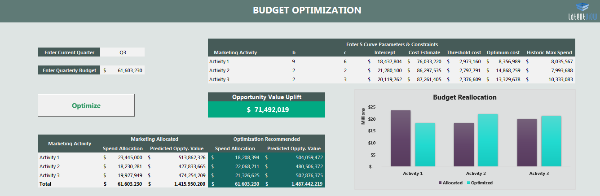





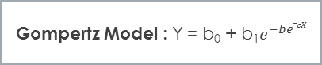
Self-Service Platform for Media Mix Modelling and Budget Optimization
Top Global Technology Solution & Service Provider
The Problem: Inefficient attribution of opportunity value between online and offline activities led to sub-optimal allocation of spends
The “Before” State
LatentView Solution
The “After” State
Client only had first touch attribution mechanism to study the impact of different marketing activities which did not provide insights in to the exact impact of all activities
Developed models using Ridge regression incorporating halo impact analysis to quantify cross activity effects and S Curves to identify optimal level of investments across multiple media vehicles
Client utilized the GUI based tool to optimally allocate budget across various activities which influenced an uplift of ~ $200 Million in Opportunity value annually
Modelling
S Curve & Optimization
Seasonality Flags – Using STL analysis
S-Curve: Media
S-Curve: Field
Stage 1
Stage 2
Gompertz Model : Y = b₀ + b₁$e^{−be_cX}$
Pipeline
Media
Events
Channel Marketing
Events
Field Marketing
Paid Search
Banner/ Display
Paid Social
Traditional Media
Outbound Calling
Others
Telemarketing
Digital
Others
Optimum
Retention Rate – Using Ad stock transformation
Threshold
S-Curve
Lag Effect of activities – By shifting data points
Halo Impact
Halo Impact
←
Outboards
Notes:
HP Enterprises – Media Mix Modeling

Slide 84














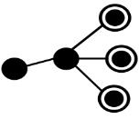






Enhance Client Relationship using Machine Learning
Leading Asset Management Company in UK
The Problem: Post Brexit, the company was experiencing significant churn & disinvestment in their fund portfolio
The “Before” State
LatentView Solution
The “After” State
Accuracy of the current process to predict disinvestments in institutional clients was only 20% accurate. And on the wholesale side, there were no systematic way to target new financial advisors with appropriate funds
Developed a comprehensive view of contacts by combining data related to their interactions, servicing & product performance which acted as input into Machine Learning models to:
Predict disinvestment - Logistic Regression
Target Fund advisors - Look Alike models
Institutional Clients – Accurate predictions of disinvestments in 60% of the cases leading to retention of mandates worth 444 Million Pounds
Wholesale Clients – Better Targeting leading to a potential investment uplift of 50 Million Pounds
Contact / Account Profiling
Institutional Client Retention
Ability to quantify level of interactions across client and prospect base
Increase ability to predict redemptions by establishing a consistent global measurement standard
Data Sources
Data Sources
Unstructured Data
Structured Data
Meetings
Meetings Content
Engagement Score
Consultant Ratings
Fund Performance
Servicing Interactions
Analytic Process
Impact
Meetings
Calls
Webcasts
Events
Web Visits
CRM
Retention Model
Logistic Regression
Retention Model captures 40% more disinvestments than the current risk evaluation
Analytic Process
Engagement Score
Wholesale Target Audience – for Funds
Promote a broad fund diversification agenda by targeting advisers with a higher propensity to invest
Priority of Interaction
Quality of Interaction
Key Insights
Data Sources
←
18% disinvestment with account with no engagement
Market Share
Transactions
Marketing Interactions
Analytic Process
Impact
The investment probability increases from 31% to 89% as the driving engagement metrics increases
Look-Alike Model
Pearson Similarity Index
Investment uplift of >£50 Million (23.6%) is expected in the leads generated using investment behavior for the fund X
84
Notes:
Standard Life Investments – Enhancing Client & Marketing Relations
Business Objective
Digital transformation & Data driven strategy to drive engagement among both institutional & wholesale clients
Maintain appropriate levels of Relationship Management & Communication Contact with clients
Institutional Clients - Reduce retention risk & Disinvestments through optimum engagement
Whole Sale Clients - Drive product diversification (Cross sell) through optimum engagement & personalized “Next Buy Offer”
LV Solution
Assessed Analytics/Data maturity
Assessed Technology landscape & Execution feasibility
Harness Data for
Governance for client engagement – Account / Contact Profiling
Alerting at Actionable early stage – Client Retention
Campaign Prospecting – Target Audience Identification
Business Impact
1) Institutional Clients - Retention Model captures 40% more disinvestments than the current risk evaluation (Model identified £444 Mn out of £804 Mn
redemptions i.e. 40% more than current process)
2) Wholesale Clients - Investment uplift of >£50 Million (23.6%) is expected in the leads generated using investment behavior for the fund X

Slide 85
Case Study in Snapshots
Data Driven Innovation
Appendix

Slide 86
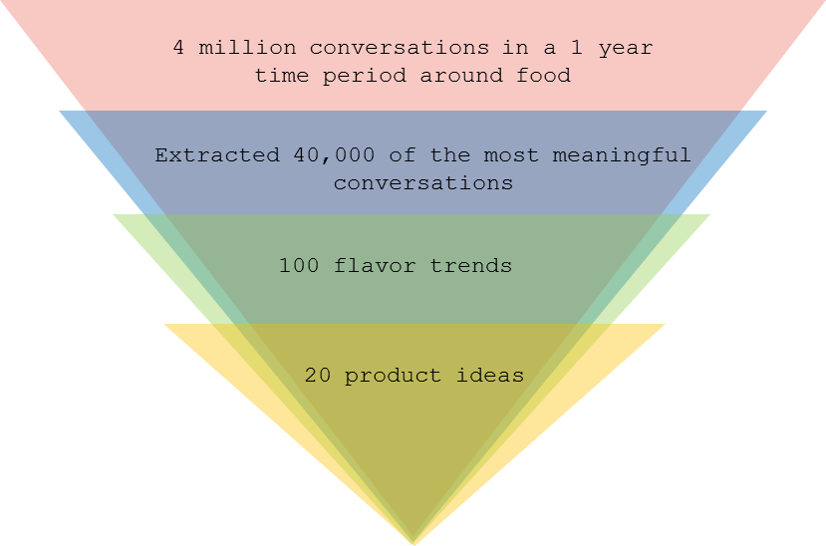
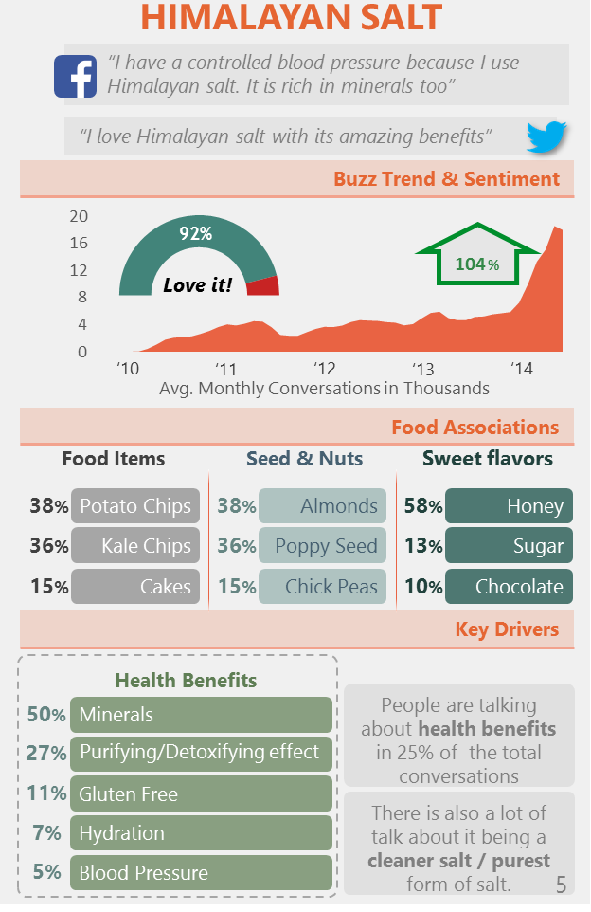
Social Media-based Flavor Trends driving Product Innovation
Leading US Based Beverages & Snack Manufacturer
The Problem: Our client’s market-share was down by 6% due to the delay in introducing new snack flavors as smaller, local competitors had a much faster time-to-market innovation cycle
The “Before” State
LatentView Solution
The “After” State
Flavor trends were identified based on surveys and focus group studies which were costly, time-consuming and lacked real-world generalization
Social media conversations were mined to identify emerging flavors and the underlying emotional and functional drivers associated with them
Reduced innovation cycle time by 1.5x, identified 20 flavors at a fraction of ideation cost and gained a big first-mover advantage
led to
←
86
Notes:
Pepsi – Flavour Trend Analysis
Business Objective:
Explore social media conversations to identify emerging ingredients in Breads, Muffins, Spreads and fillings.
Understand how a complete meal is split into different individual components and comprehend people’s mind-set on these components
LatentView Solution:
An exhaustive list of bread varieties was compiled based on market research and social media conversations were extracted for nearly 2 quarters.
Identify various ingredients or combination of ingredients based breads
Segregate the constantly emerging and seasonally emerging flavors/ingredients based on historical data
Business Benefits:
Stay close to the emotions and excitement of the consumers by studying their food habits.
Early indication of bubbling trends to increase competitive advantage
Sharpen the focus for primary research just on the flavors which has an increasing trend of buzz
Time to market is shortened.

Slide 87

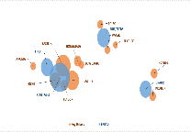



Emerging Social Media Trends driving Product Development
Leading US Based Bakery Chain
The Problem: Early identification of flavor & ingredients trends can provide a significant first mover advantage and so it is important to latch onto it before competition
The “Before” State
LatentView Solution
The “After” State
Limited understanding of consumer emotional and functional drivers . Flavor / Ingredient trends were identified using expensive and time consuming surveys and focus groups.
Cataloged a list of all bread/muffin varieties & mined relevant social conversations to identify emerging flavors / ingredients and their associated drivers (emotional, functional)
Reduced time to market by 2x, identified emerging trends early on and catered to consumer emotions and excitement increasing product overall sales and ticket sizes.
Ingredient based bread Identification
Emerging and Seasonal Flavours
Levels of Granularity
Drivers Association
Text mining
Various Ingredient Combination Identification
Social Media Buzz Analysis
Holt-Winter’s Algorithm
Benchmarking
Bucketing into Different Categories
Perception Analysis
Cross-Dimension Analysis
Intra-Dimension Analysis
380 Identified Flavours 100
238 Validation 63
Seasonal/Emerging
111 - 48
Bucketing
29-13
Fruit based breads are preferred twice as much as any other bread for Taste
Nuts & Seed based breads are closely associated with Vegan & Paleo diet. It is also preferred for its texture
TASTE
←
People looking for healthy choices of bread types prefer Vegetable based bread more than others
Close to half the conversations around Texture are associated with Nut & Seed based breads
Breads
Muffins
HEALTHY
Notes:
Ardent Mills – Bread Flavor Analysis

Slide 88
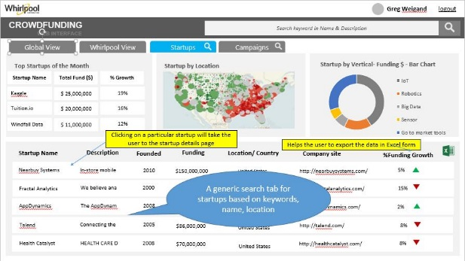
Innovation Tracking Using Crowd Funding Tool
Largest Home Appliances Manufacturer in US
The Problem: Digital disruption is revolutionizing industries and poses a significant threat who do not adapt quickly
The “Before” State
LatentView Solution
The “After” State
i
Potential innovations from new agile startups are noticed only after they have gained significant mainstream acceptance, at which time acquisition / partnership costs are higher
Built a web based data scraping, NLP and visualization platform using Octoparse, Python and MEAN stack on AWS technology to collect and visualize funding, user comments data from crowdfunding sites
An actionable list of early stage startups with periodic monitoring enabled the M&A team to evaluate the startups and begin partnership or acquisition talks 1-2 years before mainstream acceptance
Company View
←
Notes:
Whirlpool Crowd Funding tool

